Slide 1

Handwritten Arabic Text Recognition
Project Milestone 1

Slide 2
Outline
Summary of proposal
Problem statement
Related work
Progress
Comparison
To do next
Team members contribution

Slide 3
Summary of proposal
Problem statement: Handwritten Arabic Text Recognition.
Available Datasets: IFN/ENIT, AlexU-Word and KHATT.
Selected Dataset: KHATT dataset because It is the largest dataset, provides text lines images, not just words, has a simple ground truth and it is a well-organized dataset and divided into train, validation and test sets.
Available Models: discussed in Related Work.
Selected Model: HTR-Flor Model which is used to recognize English text with cursive letters like Arabic text.
Evaluation Metrics: character error rate (CER) and word error rate (WER).
Graduation Project: An OCR system to read medical prescriptions.

Slide 4

Problem Statement
Arabic Handwriting Text Recognition
A challenging problem !
More complex compared to handwritten Latin text recognition
Cursive script and joined writing
Same character variations
Large number of words
Variations in font style

Slide 5
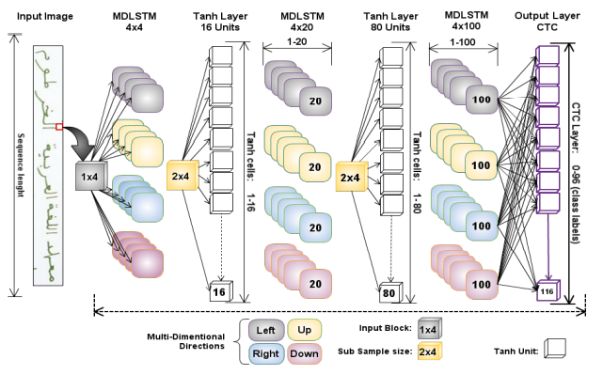
Related Work
[1] KHATT: a Deep Learning Benchmark on Arabic Script
Model Architecture
Input Layer.
3 MD-LSTM with Tanh layer.
Output Layer (CTC).
- In the notation MD-LSTM-4x4, the first 4 represents the number of directions to be scan, while the 20 represents the number of LSTM units.
- In the output layer (0-95) units represents number of classes(number of characters) + 96 unit for blank space.
- Recognition rate was 75.8%

Slide 6
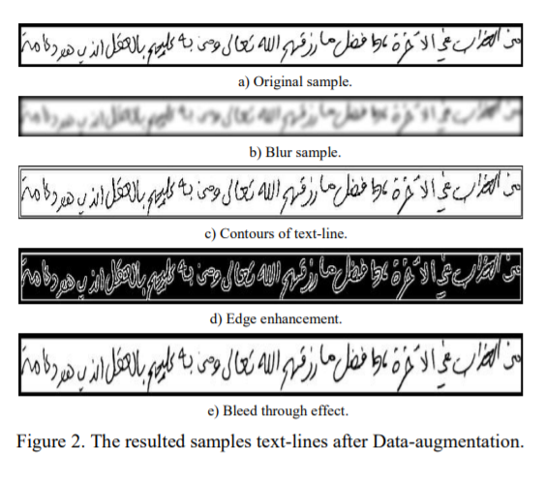
Related Work cont.
[2] A Deep Learning based Arabic Script Recognition System: Benchmark on KHAT
Same model used in the previous paper are used here but with adding data-augmentation techniques as they added 4 extra samples for each original KHATT instance and which make the results to be improved.
Recognition rate increased to 80.02%

Slide 7
Progress
Filter KHATT dataset:
Remove extra text files from ground truth to make number of images equal number of text files in the ground truth.
Find images that don’t contain text files in the ground truth and build their ground truth by hand.
Applying preprocessing on KHATT dataset:
prune the extra white regions that are present in Arabic text-lines.
de-skewe some of the Arabic text-lines that are skewed using skew detection and correction techniques.
Resize images.

Slide 8
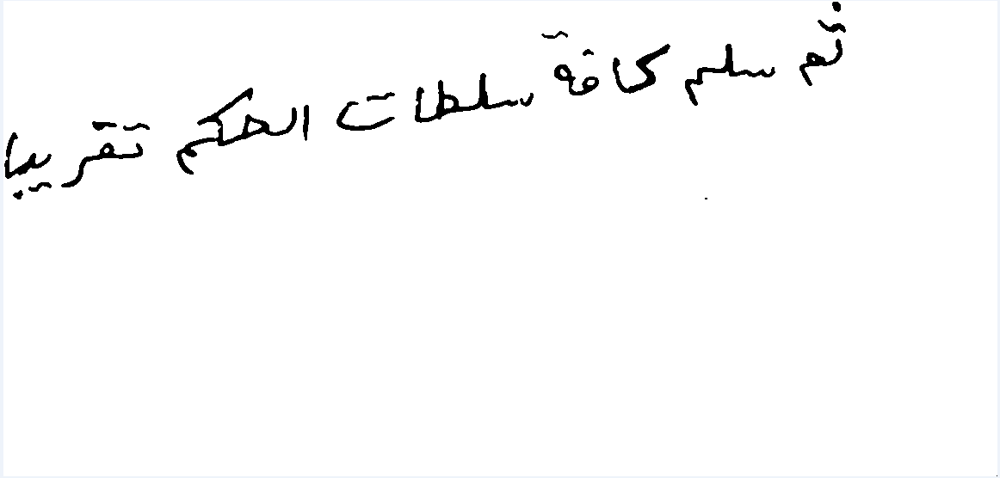
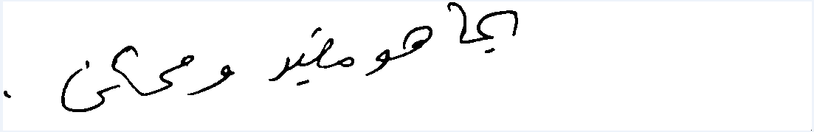
Progress cont.
Before Preprocessing | After Preprocessing

Slide 9
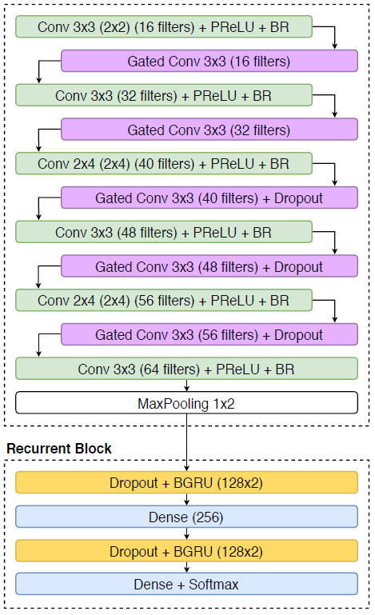
Progress cont.
Model 1 Architecture
Input Layer.
6 CONV Layer with 5 Gated CONV Layer.
Max-Pooling Layer.
2 Bidirectional GRU Layer with Dropout.
2 Dense Layer.
- Gated CONV Layer → This gated mechanism, uses all input features (x) to perform a sigmoid activation (s) and the result is a pointwise multiplication between input (original features) and output features (y = s(x) . x). Gates-CNN extracts the features from the images first before enter them to the recurrent layers.
- Output Layer contains 87 units: 86 units which represent number of classes (number of characters) + 1 unit for class blank space.

Slide 10
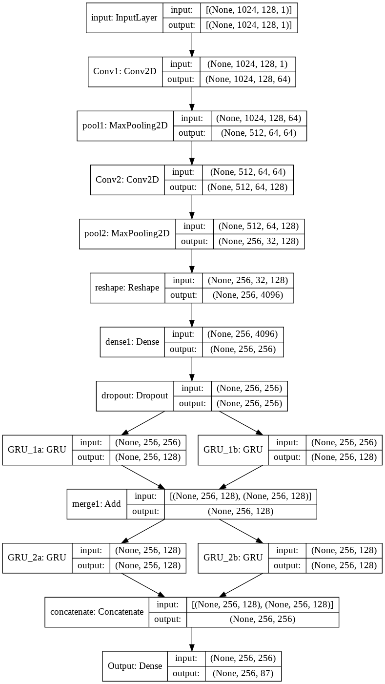
Progress cont.
Model 2 Architecture
Input Layer.
2 CONV Layer with Max-Pooling.
Dense Layer with Dropout.
2 GRU Layer.
Add Layer.
2 GRU Layer.
Concatenation Layer.
Dense Layer (Output Layer).
- Output Layer contains 87 units: 86 units which represent number of classes (number of characters) + 1 unit for class blank space.

Slide 11
Comparison
 | Model 1 | Model 2
Number of parameters | 919,527 | 1,640,279
Total time | 3:09:23 | 1:23:26
Time per epoch | 0:01:54 | 0:01:04
Train loss | 172.22 | 32.3
Best validation loss | 173.15 | 36.74
CER | 1.0 | 0.1893
WER | 1.0 | 0.5981

Slide 12
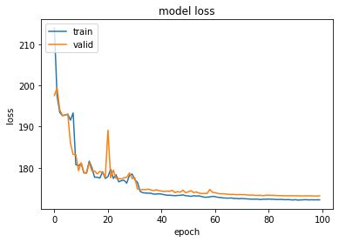
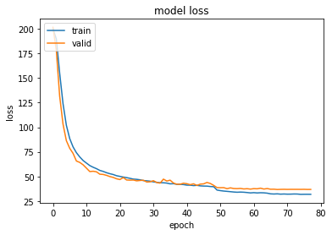
Comparison cont.
Model 1 | Model 2

Slide 13
Comparison cont.
 | NOE to get best result | CER (%) | WER(%) | Recognition Rate (%)
Related Work (1) | 70 | 19.98% | _ | 80.02%
Our Progress (2) | 68 | 18.93% | 59.81% | 81.07%
NOE → number of epochs
CER → character error rate

Slide 14
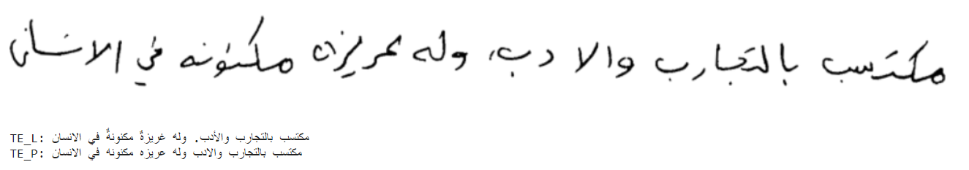

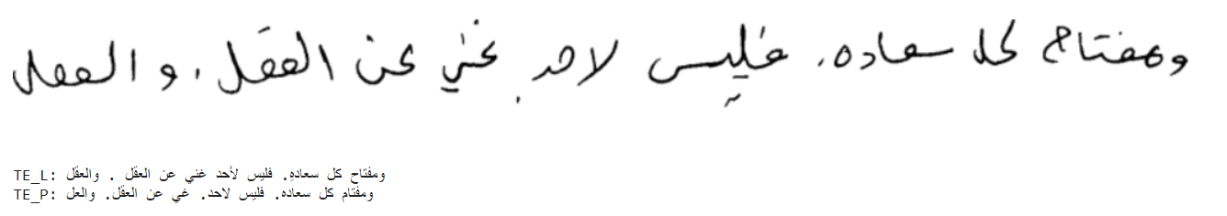

Results

Slide 15

To do next
try to tune the hyper parameters of the model to get better results on KHATT dataset
Use attention layer in model 2, we assume that we will get more improvement result.

Slide 16
Team Members contribution
Merna El-Refaie (57)
Preprocess KHATT dataset
Train Model 1
Neveen S.Nagy (61)
Filter KHATT dataset
Train Model 2
We Both
Implement and build Model 1
Search for other models to get best result

Slide 17
References
[1] KHATT: A Deep Learning Benchmark on Arabic Script
[2] A Deep Learning based Arabic Script Recognition System: Benchmark on KHAT
[3] HTR-Flor: A Deep Learning System for Offline Handwritten Text Recognition
[4] Handwritten-text-recognition Model 1
[5] Image OCR Model 2

Slide 18
Notebooks
[1] Filter KHATT Dataset
[2] Preprocess KHATT Dataset
[3] FlorModel_ArabicText --> Model 1
[4] HTRModel_ArabicText --> Model 2

Slide 19

Any Questions?!

Slide 20

Thanks!
Contact us:
Merna El-Refaie
mernamustafa1997@gamil.com
eng-merna.mustafa1621@alexu.edu.eg
______________________________
Neveen S.Nagy
neveensamirnagy@gmail.com
es-neveensamirnagy@alexu.edu.eg

